Slide 1
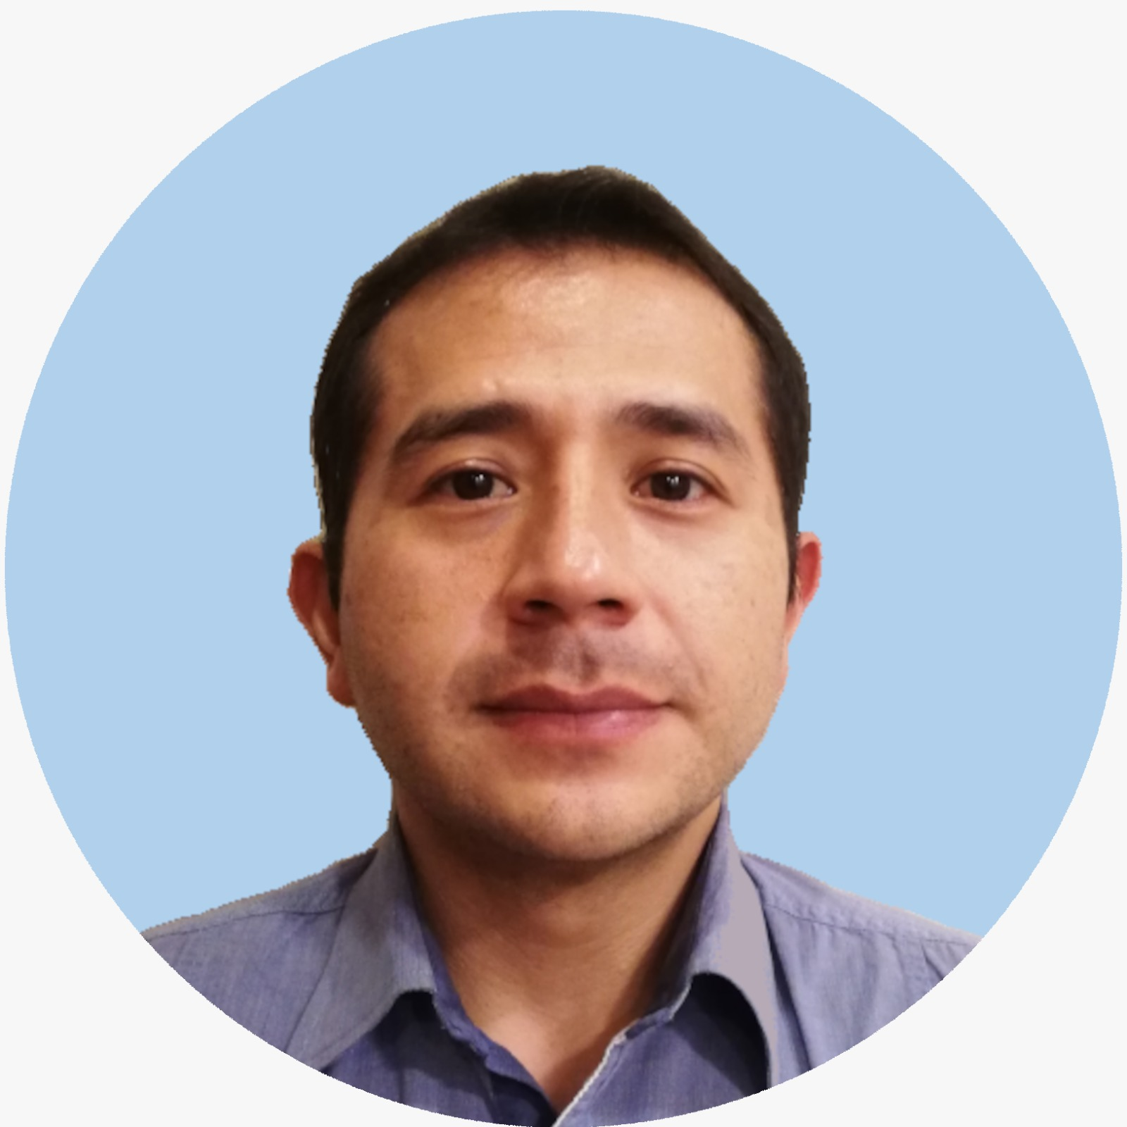
Galo Barba Project Employee — Cloud & Product
Email
galo.barba@thebridge.com
Location
Quito - Ecuador
Mobile
(+593) 999-814-088
Experienced Java Software Engineer with over 8 years of industry experience. Strong background in designing and developing web services and applications. Proficient in React, JavaScript, and AWS. Leadership, taking
initiative, team-working and making decisions. Adapting to work with new technologies and development environments.
EXPERIENCE
Industry Experience
Healthcare | Cyber Security | E-commerce: automotive l Food
Software Developer | Healthcare
Developed endpoints to be consumed by the frontend side. Used Spring framework, Java and Lombok.
Developed frontend view. Used React.
Created and improved queries. Migrated database from Marklogic to MySQL.
Consultant Developer | Cyber Security
Developed application to scan commits to VSC and notify if detects that secrets were pushed.
Developed API to allow or disallow deployments based on Veracode and ECR reports.
Developed CLI for developers to run vulnerabilities scan on their local machines.
Worked in support for customers that used applications described above.
Software Developer | E-commerce
Developed mobile application for iOS with Swift. This applications is for publishing and sell vehicles online.
Maintained web application and integrated API with the frontend.
BACKGROUND
Technologies
JEE, Spring, Hibernate, EJB, Rest, Jboss, Tomcat, React, NodeJs, GraphQL.
Languages
Proficiency Java. Strong knowledge of Javascript. Good knowledge of Python.
Databases
MySQL, Postgres, Oracle
Core Skills
Work ethic, teamwork, adaptability, compromise, effective communication, time management, problem solving

Slide 2

Email
galo.barba@thebridge.com
Location
Quito - Ecuador
Mobile
(+593) 999-814-088
Experienced Java Software Engineer with over 8 years of industry experience. Strong background in designing and developing web services and applications. Proficient in React, JavaScript, and AWS. Leadership, taking initiative, team-working and making decisions. Adapting to work with new technologies and development environments.
Galo Barba Project Employee
Cloud & Product

Slide 3
Galo Barba Project Employee — Cloud & Product
Email
Jgalo.barba@thebridge.com
Mobile
(593) 999-814-088
Location
Quito - Ecuador
BACKGROUND
EXPERIENCE
Functional Skills
Experienced Java Software Engineer with over 8 years of industry experience. Strong background in designing and developing web services and applications. Proficient in React, JavaScript, and AWS. Leadership, taking initiative, team-working and making decisions. Adapting to work with new technologies and development environments.
Technologies
JEE, Spring, Hibernate, EJB, Rest, Jboss, Tomcat, React, NodeJs, GraphQL.
Languages
Proficiency Java. Strong knowledge of Javascript. Good knowledge of Python.
Databases
MySQL, Postgres, Oracle
Core Skills
Work ethic, teamwork, adaptability, compromise, effective communication, time management, problem solving
Industry Experience
Healthcare | Cyber Security | E-commerce: automotive l Food
Software Developer | Healthcare
Developed endpoints to be consumed by the frontend side. Used Spring framework, Java and Lombok.
Developed frontend view. Used React.
Created and improved queries. Migrated database from Marklogic to MySQL.
Consultant Developer | Cyber Security
Developed application to scan commits to VSC and notify if detects that secrets were pushed.
Developed API to allow or disallow deployments based on Veracode and ECR reports.
Developed CLI for developers to run vulnerabilities scan on their local machines.
Worked in support for customers that used applications described above.
Software Developer | E-commerce
Developed mobile application for iOS with Swift. This applications is for publishing and sell vehicles online.
Maintained web application and integrated API with the frontend.

